Slide 1
Classification Metrics and ROC
PYTHON FOR DATA · 40 MIN
Accuracy, precision, recall, F1-score and the ROC curve · Unit 4
Accuracy
Share correct
accuracy_score
Precision
Trust a yes
precision_score
Recall and F1
Find the positives
f1_score
ROC curve
All cutoffs at once
roc_auc_score

Slide 2
Four Scores and a Curve
~3 min
Each one answers a different question.
A
P
R
F1
Accuracy
How many of all calls are right?
(TP+TN) / all
Precision
Of predicted yes, how many are real?
TP / (TP+FP)
Recall
Of real yes, how many were found?
TP / (TP+FN)
F1-Score
One balance of precision and recall.
2PR / (P+R)
The ROC curve then shows how these trade off across every possible cutoff.

Slide 3
Accuracy
~4 min
The share of all predictions that are right.
from sklearn import metrics as mt
actual = [1, 1, 1, 1, 1, 1, 0, 0, 0, 0]
pred = [1, 1, 1, 1, 0, 0, 0, 0, 0, 1]
cm = mt.confusion_matrix(actual, pred)
tn, fp, fn, tp = cm.ravel()
print(tp, tn, fp, fn)
print((tp + tn) / cm.sum())
print(mt.accuracy_score(actual, pred))
Output
4 3 1 2
0.7
0.7
Formula
Correct calls (TP + TN) divided by all calls. Here (4 + 3) / 10 = 0.7.
Counts first
ravel names the four counts. Every score on the next slides uses them.

Slide 4
The Accuracy Trap
~4 min
High accuracy can hide a useless model.
a2 = [0] * 95 + [1] * 5
p2 = [0] * 100
print(mt.accuracy_score(a2, p2))
print(mt.recall_score(a2, p2))
print(mt.f1_score(a2, p2, zero_division=0))
Output
0.95
0.0
0.0
Rare positives
Only 5 of 100 cases are positive. Always answering no is right 95 times.
Look deeper
Recall and F1 are 0.0, so this model finds none of the cases that matter.

Slide 5
Precision
~3 min
When the model says yes, can you trust it?
print(tp + fp)
print(tp / (tp + fp))
print(mt.precision_score(actual, pred))
Output
5
0.8
0.8
Formula
TP divided by TP + FP. The model said yes 5 times and was right 4 times.
Use it when
False alarms are costly, such as marking good email as spam.

Slide 6
Recall
~3 min
Of the real positives, how many were caught?
print(tp + fn)
print(round(tp / (tp + fn), 2))
print(round(mt.recall_score(actual, pred), 2))
Output
6
0.67
0.67
Formula
TP divided by TP + FN. There are 6 real positives and 4 were found.
Use it when
Misses are costly, such as screening for a disease. Recall is also called sensitivity.

Slide 7
F1-Score
~4 min
The harmonic mean punishes a weak side.
p, r = 0.9, 0.1
print((p + r) / 2)
print(round(2 * p * r / (p + r), 2))
print(round(mt.f1_score(actual, pred), 2))
Output
0.5
0.18
0.73
Plain average
Precision 0.9 and recall 0.1 average to 0.5, which looks fine.
Harmonic mean
F1 gives 0.18. It stays low unless both precision and recall are good.

Slide 8
Precision Versus Recall
~5 min
The cutoff trades one for the other.
import numpy as np
y = [0, 0, 1, 0, 1, 1, 0, 1, 1, 0]
scores = np.array([0.1, 0.3, 0.35, 0.4, 0.45,
0.6, 0.65, 0.7, 0.8, 0.9])
for t in (0.3, 0.5, 0.7):
guess = (scores >= t).astype(int)
p = mt.precision_score(y, guess)
r = mt.recall_score(y, guess)
print(t, round(p, 2), round(r, 2))
Output
0.3 0.56 1.0
0.5 0.6 0.6
0.7 0.67 0.4
Low cutoff
At 0.3 every real positive is found (recall 1.0), but many false alarms appear.
High cutoff
At 0.7 precision rises to 0.67, but recall drops to 0.4.

Slide 9
Averages for Many Classes
~4 min
One score per class, then combine.
a3 = [0, 0, 0, 1, 1, 1, 2, 2, 2, 2]
p3 = [0, 0, 1, 1, 1, 2, 2, 2, 2, 0]
for avg in ("macro", "micro", "weighted"):
p = mt.precision_score(a3, p3, average=avg)
print(avg, round(p, 2))
Output
macro 0.69
micro 0.7
weighted 0.7
macro
The plain average over classes. Every class counts equally.
micro and weighted
micro pools all calls together. weighted averages by class size.

Slide 10
ROC Points
~5 min
One point for every cutoff.
fpr, tpr, thr = mt.roc_curve(y, scores)
print(fpr.round(2).tolist())
print(tpr.round(2).tolist())
print(thr[1:].round(2).tolist())
Output
[0.0, 0.2, 0.2, 0.4, 0.4, 0.6, 0.6, 1.0]
[0.0, 0.0, 0.4, 0.4, 0.8, 0.8, 1.0, 1.0]
[0.9, 0.7, 0.65, 0.45, 0.4, 0.35, 0.1]
TPR and FPR
TPR is recall, TP / (TP + FN). FPR is FP / (FP + TN), the share of real negatives wrongly flagged.
Thresholds
Each cutoff gives one point. A starting point (0, 0) is added with an infinite cutoff.

Slide 11
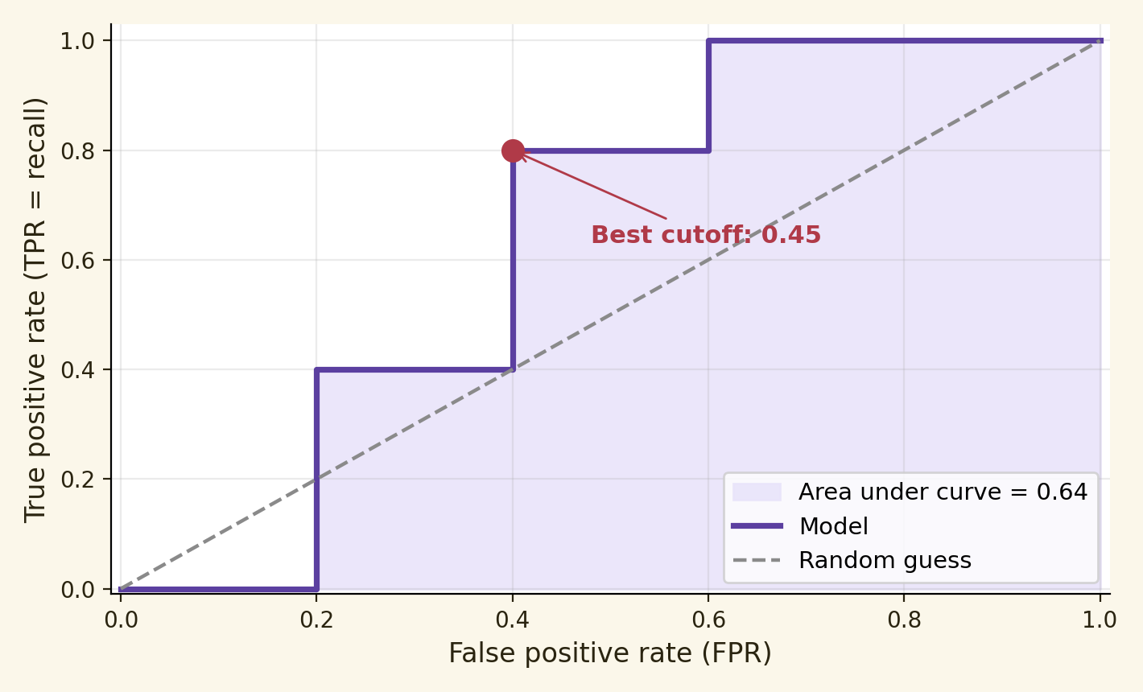
Reading the ROC Curve
~4 min
Plot TPR against FPR for every cutoff.
Up and left is better
A perfect model hugs the top-left corner. The dashed line is a random guess.
Moving along the curve
A lower cutoff moves up and right: more positives found, more false alarms.

Slide 12
AUC: Area Under the Curve
~4 min
One number for the whole curve.
print(round(mt.roc_auc_score(y, scores), 2))
print(mt.roc_auc_score(y, y))
print(mt.roc_auc_score(y, scores[::-1]))
print(mt.auc(fpr, tpr))
Output
0.64
1.0
0.36
0.64
Scale
1.0 is perfect and 0.5 is a random guess. Our scores give 0.64, only a little better than chance.
Below 0.5
Reversing the scores gives 0.36. The ranking is worse than random.

Slide 13
Pick a Cutoff From the Curve
~4 min
Largest gap between TPR and FPR.
j = tpr - fpr
best = j.argmax()
print(round(thr[best], 2), round(j[best], 2))
print(round(tpr[best], 1), round(fpr[best], 1))
Output
0.45 0.4
0.8 0.4
Youden's J
TPR minus FPR. The cutoff with the largest J is a balanced choice: 0.45.
At that point
It finds 80 percent of positives and flags 40 percent of negatives.

Slide 14
Which Score Fits?
~3 min
Pick the score that matches the cost.
Situation | Score
Classes are balanced | Accuracy
False alarms are costly | Precision
Misses are costly | Recall
Both errors matter | F1-score
Compare models over all cutoffs | ROC AUC
Very rare positive class | Precision and recall
Never report accuracy alone when one class is rare.

Slide 15
Metrics and ROC Cheat Sheet
~3 min
Match the task to the tool.
Task | Tool
Share correct | accuracy_score
Trust in a yes | precision_score
Positives found | recall_score
Balance of the two | f1_score
ROC points | roc_curve(y, scores)
Area under the curve | roc_auc_score
Scores for ROC need probabilities or decision scores, not hard 0 and 1 labels.

